Slide 1

WELCOME
TO
HEALTHY U GATHERINGS:
MAKING PEACE WITH YOUR PAST

Slide 2
What do we hope to learn?
Increased awareness of influence the past has on today
Useful language to help describe hurtful past experiences
Practical steps to overcome past hurts
*

Slide 3
“Leave The Past in The Past”
Just get over it and move forward
Forget about it and focus on the future
Let go and let God

Slide 4
“Leave The Past in The Past”
You shouldn’t feel that way
Be thankful that it’s over
You should be over it by now

Slide 5
“Leave The Past in The Past”
Impact Inventory
Evaluation of Influence

Slide 6
“Leave The Past in The Past”
Impact Inventory
What happened?
How did it make you feel?
What were the outcomes?

Slide 7
“Leave The Past in The Past”
Evaluation of Influence
Emotional
Physical
Mental
Spiritual
Financial
Relational

Slide 8
Putting Words To How I Feel
Connectedness
Intensity

Slide 9
Putting Words To How I Feel
Angry Frustrated Irritated Mad Depressed
Hopeless Helpless Confused Unsure Bad
Tired Worn Out Struggling Regretful Sad
Numb Lifeless Listless Achy Crazy

Slide 10
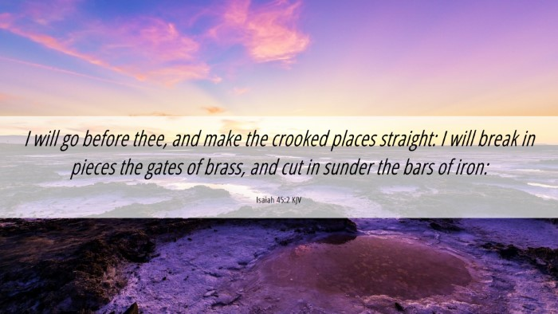
Moving Forward

Slide 11
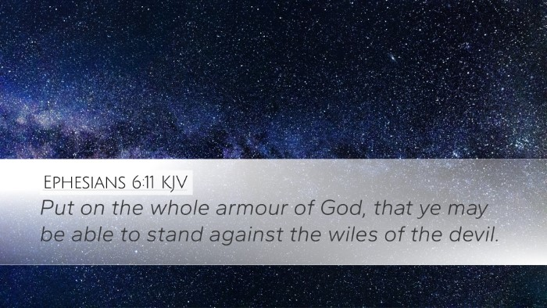

Slide 12
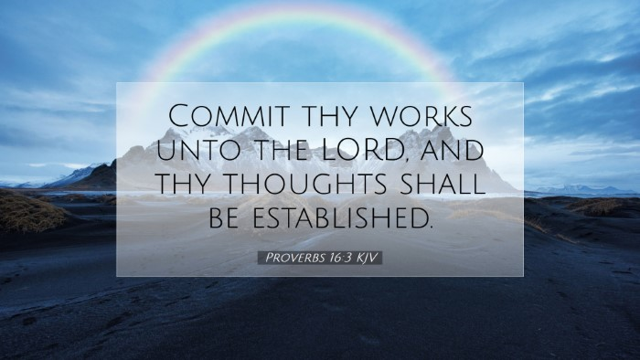

Slide 13


Slide 14
Beyond Today
careministries@brookwoodchurch.org
(864) 688-8355
https://www.brookwoodchurch.org/help

Slide 15
Table Time
Discuss the Reflection questions

